Slide 1
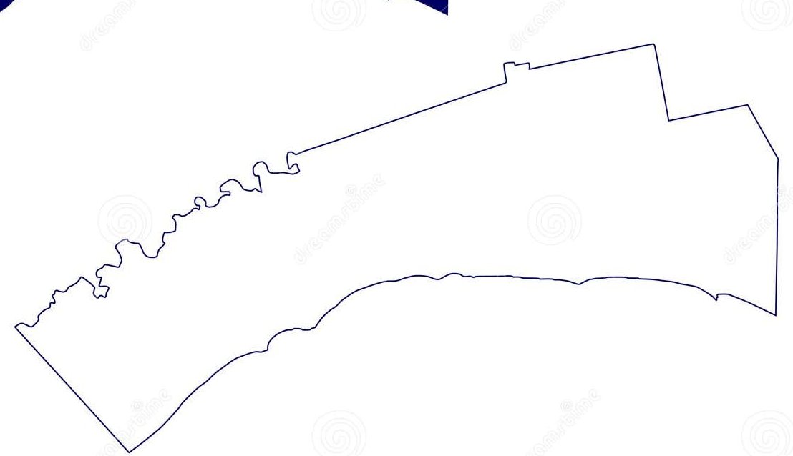

Elgin Neighbourhood Health Home Model
Integrated Planning & Clinical Leadership
Regional Service Delivery & Academic Affiliation
West Elgin Neighbourhood
Central Neighbourhood
East Elgin Neighbourhood
Satellite Site
Satellite Site
Satellite Site
Central
Hub
Community Paramedicine
Each neighbourhood provides the following services:
Mobile outreach
West Elgin Spoke
Satellite Site
Primary Care
Satellite Site
Satellite Site
East Elgin Spoke
Satellite Site
Social Care & Community Supports
Satellite Site
Satellite Site
Ambulatory Care / Specialist Teams
Coordinated After Hours Care

