Slide 1

GBE Business Plan
City of Port Colborne
October 2025

Slide 2
Disclaimer
Purpose
The sole purpose (the “Purpose”) of this Business Plan report (“Report”) is to provide preliminary information on The Town of Port Colborne’s expansion of Water and Wastewater capacity (the “Investment”) to Port Colborne’s city council.
This Report and the contents herein do not, and are not intended to, constitute an offer for sale, prospectus, invitation to subscribe for or purchase or otherwise acquire, shares or other securities in the Investment. For the avoidance of doubt, there is no intention to create a legal relationship and such relationship will not come into existence unless and until a formal contract has been entered into in relation to the acquisition of the Investment or its assets.
Use of materials
This Report is provided to the person in possession of it (the “Recipient”) on the understanding that:
the Recipient will only use this Report and the information contained herein (except to the extent that the same is already in the public domain) for the Purpose;
this Report and all other information supplied will not be copied, reproduced or distributed to others at any time without the prior written consent of the Investment (other than to directors, officers, employees and professional advisers of the Recipient who need to know the information contained in this Report for the Purpose);
upon request, the Recipient will promptly return to Doane GTCFI all material received without retaining any copies thereof, and will destroy any information derived from the material; and
the Recipient will advise other persons with whom the Report is properly shared of the provisions of this undertaking.
Verification of information
The information contained in this Report has been provided by the management of the Investment solely for the Purpose and has not been checked or verified by Doane GTCFI. No representation or warranty express or implied is or will be made, and no responsibility or liability is accepted by the Investment, Doane GTCFI, or any of their respective affiliates and associates or their directors, officers, employees, agents, shareholder or advisors as to, or in relation to, the shares, business or prospects of the Investment, or with respect to the adequacy, accuracy, completeness or reasonableness of the facts, opinions, estimates, forecasts, projections or other information set out in this Report or any further information, written or oral or other, supplied in connection with it or omitted therefrom.
Nothing contained within this Report is or should be relied upon as a promise or representation as to the future. The financial information (historical, forecast or pro-forma) contained in this Report was prepared expressly for use in this Report and is based on certain assumptions and management’s analysis of information available at the time this Report was prepared. There is no representation, warranty or other assurance that any of the forecasts will be realized.
The Report includes certain statements with respect to the anticipated future performance of the Investment, further details of which may be made available to the Recipient in relation to the Purpose. Such statements, which reflect various subjective assumptions concerning anticipated results, may or may not prove to be accurate, correct or complete. No representations or warranties express or implied, are made as to the accuracy of such statements.
The information contained in this Report and any further information relating to the Investment is, and will be, supplied on the condition that none of the Investment, Doane GTCFI, or any of their respective affiliates and associates (or any director, officer, shareholder, partner, employee, agent or advisor of any of them) accepts any responsibility and/or liability for any loss or damage of whatsoever nature that may result or occur by reliance on such information and howsoever arising.

Slide 3
Disclaimer
Verification of information (continued)
The Recipient shall only be entitled to rely on the representations and warranties, if any, made in any final executed definitive agreements with
the Investment. Recipients are responsible for satisfying themselves as to
the accuracy and completeness of all information contained herein.
No offer or solicitation
Doane GTCFI confirms that it is registered as an Exempt Market Dealer as defined under Canadian securities laws.
No securities commission or securities regulatory authority in Canada,
the U.S., or any other jurisdiction has in any way passed upon the merits
of this opportunity or the accuracy or adequacy of the Report. The Report does not constitute an offer or solicitation in any jurisdiction to any person to whom it is unlawful to make such an offer or solicitation. The Report is not, and under no circumstances is to be construed as a prospectus, a public offering, or an offering Report as defined under applicable securities legislation.
Sundries
References in the foregoing paragraphs to partners in Doane GTCFI include references to partners in its associated partnerships and to the employees
of Doane GTCFI.
Further information
In furnishing this Report, Doane GTCFI and the Investment reserves the right to amend or replace the Report at any time. However, neither Doane GTCFI nor the Investment is under any obligation to provide the Recipient with access to any additional information or to update or correct any inaccuracies which may become apparent in this Report, or any other information made available in connection with the Report.
Contact
All questions and enquiries regarding the Report or the Investment should be directed to the following individuals:
Troy MacDonald
CPA, CA, CBV
Managing Director, Transactions
T +1 416 369 6401
E Troy.MacDonald@doane.gt.ca
Peter Cummins
ACA (CAI)
Associate Director, Transactions
T +1 647 329 0566
E Peter.Cummins@doane.gt.ca

Slide 4
Contents
Purpose and DGT’s Role 05
Strategic Context 08
Delivery & Oversight 12
Agreements & Financing 18
Geographic Scope & Milestones 22
Public Value & Engagement 25
Performance & Resilience 30
Appendix 33

Slide 5
Purpose and DGT’s Role

Slide 6

Purpose of the Business Plan
This business plan report has been prepared by Doane Grant Thornton (DGT) based on information provided by City management.
Its purpose is to consolidate relevant financial, governance, and infrastructure details to support Council’s understanding of the East Side Employment Lands (ESEL) servicing initiative.
DGT has compiled this report for informational purposes only. No recommendations, opinions, or endorsements are being made. The content reflects management-supplied data, assumptions, and projections, and should be interpreted as such.

Slide 7
DGT’s Role in the Business Plan
DGT is acting as the primary financial advisor for the city during this project’s development and planning
DGT is acting as the financial advisor to the City in relation to the ESEL servicing initiative. Our role is focused exclusively on financial matters, including:
Structuring and evaluating financing options
Assessing debt implications and repayment capacity
Supporting financial modeling and forecasting
Reviewing revenue mechanisms and long-term sustainability
It is important to clarify that DGT is not providing legal, technical, or engineering advice. Any references to legal agreements, infrastructure design, or operational matters are based solely on information provided by City staff and external consultants.
This business plan reflects management’s inputs and assumptions, and DGT’s role is to ensure financial clarity - not to validate non-financial content.

Slide 8
Strategic context

Slide 9





Executive Summary
5km
Port Colborne’s water and wastewater network is expanding:
To support the planned development of a lithium-ion battery facility in Port Colborne by Asahi Kasai (“AK”) the city has been asked to expand its water and wase water capabilities to service the manufacturing facility worth $1.6 billion.
The City has executed an agreement with AK regarding the terms of an agreement that would provide a minimum purchase of water and wastewater volume to provide certainty regarding the usage of the planned water and wastewater network expansion.
The City’s preliminary estimates place the total project funding requirement at $32.4 million, with financing to be evenly shared between public and private lenders. Debt repayment will be sourced from revenues generated under the Master Purchase Agreement (MPA) with AK.
The current proposal involves setting up a municipal services corporation (“MSC”) that will be classified as a government business enterprise (“GBE”) for accounting purposes, to hold and operate this Investment.
The MSC will be 100% municipally owned, governed by an independent board and will allow infrastructure expansion, debt capacity optimization and long-term service sustainability.
Of new pipe added to Port Colborne’s network
12%
Projected increased to property tax base upon completion of Phase 1 of the project¹
300
Expected number of jobs to be added following the completion of phase one
2027
Expected year for system expansion to be brought online
¹Increase achieved after tax increment grant expires in 10 years

Slide 10
Objectives of the Project
The objectives of the project is to deliver water and wastewater infrastructure to support the development of the ESEL, the AK Battery Separator Plant, and future residential lands in Port Colborne. This includes the creation of a new water district and the establishment of two MSCs to own, manage, and finance the infrastructure assets required for servicing.
The project enables:
Timely delivery of water and wastewater services to meet AK’s operational timeline for Phase 1 by Q3 2027.
Long-term servicing capacity for industrial and residential growth in the ESEL and surrounding lands.
A sustainable financial model through fixed and variable service charges, ensuring predictable revenue to cover capital and operating costs.
Clear asset ownership and governance through the MSC structure, with a HOLDCO providing oversight and the Region assuming operational responsibilities over time.
This infrastructure investment is part of Port Colborne’s economic development strategy. It also supports long-term housing and industrial growth across the ESEL.

Slide 11
Justification & Strategic Rationale
Strategic Alignment
The project directly supports AK’s $1.6 billion investment and the development of the ESEL, aligning with Port Colborne’s infrastructure program and long-term economic growth strategy.
Timely Infrastructure Delivery
Water and wastewater services are scheduled to meet AK’s operational needs, with water infrastructure in place by April 2026 and wastewater systems by September 2027, ensuring the project remains on track.
Financial Sustainability
The MSC structure enables off-balance-sheet financing, backed by long-term service agreements with AK and future users. This model ensures predictable revenue streams to cover both capital repayment and ongoing operational costs, minimizing financial risk to the City.
Governance and Ownership
Infrastructure assets will be owned by a dedicated MSC, which will also hold the project’s debt. A separate HOLDCO will act as the sole shareholder, providing governance oversight and ensuring alignment with municipal objectives. The HOLDCO is structured to allow ownership of additional assets in the future, offering flexibility for broader municipal investment opportunities. Operational responsibilities will transition to the Niagara Region post-construction, ensuring long-term service continuity.
Scalable Growth and Economic Impact
The infrastructure is designed to exceed the immediate needs of AK, enabling future industrial and residential development across 1,000 acres. The project is expected to create 300 direct jobs and stimulate broader regional economic activity through supporting industries.

Slide 12
Delivery & Oversight

Slide 13
Service Delivery Model
The servicing project will be delivered through a coordinated infrastructure plan anchored by the creation of two MSCs. This structure enables efficient delivery of water and wastewater services while maintaining financial and operational separation from the City’s core administration.
Infrastructure Scope and Ownership
The Infrastructure MSC will own all physical servicing assets within the newly established water district, including watermains, wastewater pumping stations (ESEL and Snider Road), and associated forcemains. It will also hold the debt required to finance the project, creating a dedicated vehicle for infrastructure investment that operates independently from the City’s balance sheet.
Roles in Design, Construction, and Operations
The City will oversee the initial design and construction phases to ensure compliance with municipal standards. Upon completion, the Niagara Region will operate and maintain the wastewater pumping stations and forcemains on behalf of the MSC. A full asset transfer to the Region is anticipated at a later stage.
Revenue Generation Model
Long-term service agreements with AK and future users will provide predictable revenue streams through fixed and variable charges. These revenues will support both capital repayment and ongoing operational costs, ensuring long-term financial sustainability.
Appendix A provides a visual overview of the infrastructure and service delivery evolution, illustrating the transition from current state through construction and into post-construction operations.

Slide 14
Governance Structure
The governance framework is designed to provide transparency, accountability, and alignment with municipal objectives through a two-tier MSC structure.
Independent Oversight via the Infrastructure MSC
The Infrastructure MSC will operate independently from the City’s day-to-day administration, allowing for focused oversight of infrastructure delivery and financing. This independence supports agile decision-making and dedicated management of complex servicing assets.
Strategic Control through the HOLDCO
The HOLDCO will act as the sole shareholder of the Infrastructure MSC. Governed by a Board of Directors appointed by Council, the HOLDCO will include municipal staff and external advisors with relevant expertise. The Board will be responsible for strategic oversight, financial stewardship, and ensuring the MSC adheres to its mandate and municipal priorities.
Transparency and Reporting Mechanisms
To maintain accountability, the HOLDCO will convene an Annual General Meeting (AGM) to present audited financial statements, operational updates, and strategic plans. Council will receive regular updates through formal reporting channels, including annual reports, performance dashboards, and milestone briefings tied to servicing delivery and financial performance.
Governance Outcome
The structure is designed so that Council retains visibility and strategic control over the servicing initiative, while empowering the MSC to operate with the flexibility required to manage infrastructure and financing effectively.
Legal Advisory Support
The City has been advised on the governance structure by Borden Ladner Gervais LLP (BLG), ensuring alignment with applicable legislation and best practices in municipal governance.

Slide 15
Risk Management Framework
The servicing project introduces a range of financial, legal, operational, and industry-specific risks that must be proactively managed through a robust governance and oversight framework. The establishment of two MSCs is intended to help isolate and mitigate these risks, create an effective governance model, and meet compliance requirements.
Risk Overview
Financial Risk: The Infrastructure MSC will hold the debt associated with the servicing project, separating financial exposure from the City’s core operations. Long-term service agreements with AK and future users is intended to provide predictable revenue streams to cover capital and operating costs, supporting lender requirements and financial sustainability.
Legal Risk: All agreements - including those with AK, the Niagara Region, and lenders - have been reviewed by legal counsel to ensure enforceability and protection of municipal interests. The MSC structure also limits liability by operating as a distinct legal entity.
Operational Risk: Infrastructure delivery is tied to critical timelines, particularly AK’s Phase 1 launch in Q3 2027. To manage this, the City has retained qualified contractors and partnered with the Niagara Region for operations and maintenance. The MSC will oversee asset performance and ensure service continuity.
Governance and Oversight Risk: A qualified Board of Directors will be appointed to the HOLDCO for oversight of the MSC’s financial and operational activities. The Board will be responsible for developing and maintaining a comprehensive risk mitigation strategy that outlines how risks will be managed without impacting the municipality.
Regulatory Compliance Risk: The project must meet all requirements under the Drinking Water Protection Act and other applicable legislation. The MSC will be mandated to prioritize full compliance with provincial standards, supported by regional expertise and operational protocols.

Slide 16
Risk Management Framework (continued)
Risk overview (continued)
Municipal Oversight Risk: Council will retain visibility through regular reporting, including AGMs, audited financial statements, and milestone updates. This is intended to monitor and mitigate risk and protect municipal interests throughout the project lifecycle.
EV Industry Risk: The servicing project is closely tied to the success of the AK Battery Separator Plant, which operates within the rapidly evolving electric vehicle (EV) industry. Market volatility, technological shifts, and global supply chain disruptions could impact AK’s operations and, by extension, the servicing strategy.
Counterparty Reliance Risk: The financial model relies heavily on AK as the anchor user. Any changes in AK’s business plans, financial health, or contractual commitments could materially affect revenue projections and infrastructure utilization.
Cost Overrun Risk: While project budgets have been established, there remains a risk of cost overruns due to unforeseen construction, regulatory, or environmental factors. Recovery of these overruns is expected to occur through future development charges, which may take time to materialize and could impact short- to medium-term financial performance.

Slide 17
Environmental & Regulatory Compliance
The water and wastewater servicing project for the ESEL is being delivered in alignment with environmental and regulatory standards through coordinated planning and intergovernmental agreements.
Environmental Planning
Infrastructure design includes geotechnical investigations and engineering studies to support the Welland Canal crossing and surrounding area.
The project supports the City's strategic pillar of Environment and Climate Change, as outlined in the Strategic Plan.
Regulatory Compliance
All infrastructure is being constructed to Niagara Region standards, ensuring compliance with regional and provincial requirements.
The project is subject to the Municipal Act, which governs the establishment of a GBE and requires public consultation.
Governance Integration
The infrastructure will be transferred to the Region upon completion, ensuring long-term operational oversight and regulatory adherence.
The GBE structure enables the City to manage infrastructure delivery while maintaining compliance through shared service agreements and formal governance mechanisms.

Slide 18
Agreements & Financing

Slide 19
Water and Wastewater Agreement with AK
Strategic Infrastructure Partnership
The City of Port Colborne has executed a comprehensive agreement with AK to fund and deliver water and wastewater infrastructure for the ESEL. This supports the development of a $1.6 billion battery separator plant and future industrial expansion.
Financial Terms & Cost Recovery
The agreement establishes a 20-year partnership with renewal options, ensuring long-term collaboration and service continuity. A project cost ceiling of $32.4 million is set, with any overages covered through development charges or future users.
All infrastructure and operating costs are intended to be recovered from AK and future ESEL users, ensuring no cost to City taxpayers. The rate structure includes built-in contingencies for 15% water loss and 15% inflow/infiltration, supporting full cost recovery and system resilience.
Capacity Allocation & Expansion
AK is guaranteed 50% of pipe capacity, subject to pumping station limits. Future pump station expansions will be co-funded: 50% by AK and 50% by future users.
Legal Advisory Support
BLG LLP has acted as legal counsel to the City for the negotiation and finalization of the infrastructure agreement with AK, ensuring alignment with municipal interests and legal requirements.

Slide 20
Water and Wastewater Agreement with AK (continued)
Infrastructure Responsibilities
The City/GBE will construct water and wastewater infrastructure up to the “External City Works Connection Point” at Third Concession and Snider Road. One Forty Developments will build infrastructure from the connection point to AK’s site, at their own cost and to City specifications.
Governance & Operational Oversight
The agreement will be transferred to the GBE within the newly created ESEL Water and Wastewater District. A HOLDCO will oversee governance, ensuring alignment with municipal objectives and enabling off-balance-sheet financing. The Niagara Region will assume responsibility for operating and maintaining the wastewater pumping stations and forcemains once construction is complete and conditions are met.
Risk Management & Status
The agreement includes termination and default provisions to protect the City and GBE. Confirmation from the Niagara Region is intended to ensure adequate water supply and wastewater treatment capacity for current and future needs. Final approval is pending within AK’s organization, with execution expected upon fulfillment of all conditions.

Slide 21
Project Funding Overview
The GBE is financially positioned to support construction through the financing, maintain positive cash flow, and meet its debt obligations over the life of the asset.
The GBE’s revenue projections are anchored in the terms outlined in the MPA with AK.
Operating cost estimates have been provided by City Management and include expenses related to repairs and maintenance, wages and board member compensation, service agreements, insurance, professional fees, interest, and other administrative costs.
To fund the project, the corporation will require $32.4 million in financing, which will be split evenly between public and private lenders.
This funding will support the construction of key infrastructure components, including a watermain, a wastewater forcemain, and a wastewater pumping station.
Key Highlights
No impact on current ratepayers: All costs are intended to be recovered from AK and future ESEL users.
Cost ceiling of $32.4M: Overages covered by development charges or future users.
Regional partnership: The Niagara Region to assume ownership of pumping stations and force mains post-construction.

Slide 22
Geographic Scope & Milestones

Slide 23
Geographic Scope
Project Location
The project is located in the northern corridor of Port Colborne, within the Niagara Gateway Economic Zone. It includes the ESEL, which are currently unserviced but zoned for industrial use, and the AK Battery Separator Plant site, situated just north of Forkes Road.
Infrastructure Reach
A new water district is being established to encompass the ESEL, the AK site, and adjacent industrial lands. This district will be serviced by new watermains, wastewater pumping stations, and forcemains, all owned and financed by the MSC.
Regional Integration
The Niagara Region is constructing a tunnel beneath the Welland Canal to connect regional infrastructure with the local servicing network. The City of Port Colborne will lead the design and construction of local systems, while the Region will operate and eventually assume ownership of key assets.
Appendix B contains a map detailing the location of the project.

Slide 24
Project Timeline
May 2024
AK announced it would construct an Integrated lithium-ion battery separator plant
November 2024
AK purchases the un-serviced land from BMI consortium.
AK/One Forty Development Inc./City sign Development Agt.
AK groundbreaking
January 2025
ROMA - HEWSF + Hydro and Highway access
March 2025
Federal CHIF - $19.25 million ($38.5 million projects)
April 2025
Good Roads – HEWSF + Hydro and Highway access
June 2025
Hydro One takes lead to supply hydro to the project
$4.3 million Early Works Agreement with Peters Construction Group
August 2025
Provincial HEWSF $11.3 million ($15 million projects)
September 2025
$4 million extension of Early Works Agreement with Peters Construction Group
October 2025
Council Approval
November 2025 (Est.)
Water and Wastewater District GBE established.
Interim project financing to Council for approval
January 2026 → December 2027 (Est.)
Water available at AK site (April 1, 2026)
Signed wastewater pumping station construction agreement
Wastewater available at AK site (September 30, 2027*)
Financing Completed
GBE “Stand-alone”
The project team’s goal is to establish the viability of a GBE structure for this investment prior to construction commencing. Over the course of the coming months the project team will provide regular updates to city council regarding the project's status

Slide 25
Public Value & Engagement

Slide 26
Public Interest Considerations
The servicing project delivers significant public value across social, economic, environmental, and financial dimensions, while ensuring long-term sustainability and regulatory compliance.
Social & Economic Impact: By enabling the development of the ESEL, the project supports job creation, industrial expansion, and regional investment. The AK Battery Separator Plant serves as a catalyst for growth, attracting additional users and positioning Port Colborne as a hub for advanced manufacturing. This unlocks new employment opportunities, strengthens the local economy, and aligns with the City’s Global Business Enablement strategy.
Environmental Stewardship: The infrastructure plan has been designed in coordination with environmental reviews and geotechnical investigations to ensure responsible land use and minimal ecological disruption. Integration with The Niagara Region’s systems ensures that water and wastewater services meet provincial standards for treatment and sustainability.
Financial Sustainability: The project leverages a MSC to finance infrastructure independently of the City’s balance sheet, preserving municipal borrowing capacity. Long-term service agreements with AK and future users ensure predictable revenue to cover capital and operating costs, supporting financial resilience and lender confidence.
Rate Stabilization: The project provides an opportunity to re-establish water and wastewater rates based on actual servicing costs and long-term financial modeling. This ensures fairness, transparency, and affordability for all users within the new water district, while supporting the financial resilience of the system.
Industrial Expansion: The infrastructure investment lays the groundwork for expanding the industrial park beyond AK, creating a scalable platform for future development. This supports the City’s strategic goals and enhances its competitiveness in attracting high-value employers with access to multi-modal transportation options including highway, canal, and rail.

Slide 27
Key stakeholders' considerations
Stakeholder | Considerations
City of Port Colborne | Leads project coordination, governance, and oversight through its internal team and Council. Initiates agreements and establishes the MSC structure.
Niagara Region | Partner in infrastructure delivery, especially for the Welland Canal crossing and wastewater systems. Will assume ownership and operational responsibility for key assets post-construction.
Asahi Kasei | Anchor industrial tenant whose development timeline drives infrastructure delivery. Financial contributor through long-term service agreements.
One Forty Developments | Constructs infrastructure from the City’s connection point to the AK’s site, at their own cost and to City specifications.
Contractors (e.g., Peters Excavating) | Engaged to deliver linear infrastructure assets under approved construction agreements.
City Solicitors & Financial Advisors | Provide legal and financial guidance on agreements, MSC structure, and financing strategies.
Community & Public | Will be engaged through a formal public consultation process as required under the Municipal Act, including public reports and open house sessions.

Slide 28
Stakeholder Consultation
The servicing project has been guided by extensive consultation with public, private, and community stakeholders to ensure alignment with strategic priorities, regulatory requirements, and long-term infrastructure goals.
Internal Collaboration: City staff—including the CAO, Director of Development and Government Relations, Director of Public Works, Manager of Special Projects, and Senior Project Manager—have worked closely to coordinate all aspects of the servicing project. This includes the development of water, legal, and financing agreements in collaboration with City Solicitors, strategic financial advisors, and lenders.
Intergovernmental Engagement: The City has partnered with the Niagara Region to design and deliver shared infrastructure, including the Welland Canal tunnel crossing and wastewater pumping stations. These assets are being built to Niagara Region standards, with the Region expected to assume ownership and operational responsibility once construction is complete and conditions are met.
Private Sector Coordination: The City has maintained active engagement with AK to align infrastructure delivery with their development timeline. Construction agreements are in place with Peters Excavating for linear asset installation, and One Forty Developments is responsible for infrastructure from the City’s connection point to the AK site.
Legal and Financial Advisors: City staff have worked with legal counsel and strategic financial advisors to finalize the MSC structure and associated agreements.
Public Engagement: In accordance with the Municipal Act, public engagement is required for the establishment of MSCs. The City will launch a public information campaign, including updates on its website and a public open house. Several reports have already been presented to Council (2023-109, 2024-47, 2024-221, 2025-28, and 2025-139), outlining the project’s scope and progress.

Slide 29
Community Engagement Plan
The City of Port Colborne is required under the Municipal Act to conduct public consultation prior to establishing GBEs. This process ensures transparency, accountability, and alignment with public interest.
Engagement Activities
A formal public engagement campaign will be launched, including:
  Updates on the City’s website
  A public open house session
  Opportunities for residents to ask questions and provide feedback
Process & Outcomes
Feedback collected will inform the final business plan for the GBEs.
The finalized plan will be presented to Council for approval through bylaw.
Several public reports have already been presented to Council, including Reports 2023-109, 2024-47, 2024-221, 2025-28, and 2025-139.
Strategic Alignment
This engagement supports the City's strategic pillars:
  Environment and Climate Change
  Welcoming, Livable, Healthy Community
  Sustainable and Resilient Infrastructure

Slide 30
Performance & Resilience

Slide 31
Performance Measures
The Board of Directors of the MSC will be responsible for overseeing performance and ensuring alignment with shareholder expectations, financial targets, and public value outcomes. Performance measures will be established to monitor governance, financial sustainability, service delivery, and strategic impact.
Infrastructure Delivery & Financial Accountability
Cost Recovery Assurance: All infrastructure and operating costs are to be recovered from AK and future ESEL users, with no financial burden on City taxpayers.
Project Cost Ceiling: A cap of $32.4 million is set for infrastructure costs; any overages will be covered through development charges or future users.
Debt Management: Interim financing of up to $20 million approved; long-term debt impact limited to ~$8 million due to GBE structure.
Rate Structure Resilience: Built-in contingencies for 15% water loss and 15% inflow/infiltration ensure full cost recovery and system sustainability.
Governance & Oversight
GBE Structure: Enables off-balance-sheet financing and operational independence, reducing impact on City's borrowing capacity.
Board Oversight: Council-appointed board members will oversee strategic and business plans for HOLDCO and District entities.
Public Engagement: Formal consultation process underway to ensure transparency and community input on GBE establishment.
City Guarantee: During the construction phase, the City will guarantee the debt; however, the GBE will operate as a standalone entity once construction is complete.

Slide 32
Operational Oversight & Sustainability
The long-term operation and sustainability of the water and wastewater infrastructure will be supported through a coordinated governance and delivery model involving the City, the Niagara Region, and the newly established GBEs.
Operational Responsibilities
The City will oversee initial design and construction phases.
The Niagara Region will assume ownership and operational responsibility for pumping stations and force mains once construction is complete and conditions are met.
Shared service agreements will be used to procure maintenance and administrative support from the City.
Sustainability Measures
The infrastructure is designed to support long-term industrial and residential growth across the ESEL, including future users beyond AK.
The GBE structure enables off-balance-sheet financing, preserving the City’s borrowing capacity while maintaining financial independence.
Built-in rate contingencies for water loss and inflow/infiltration ensure full cost recovery and system resilience.

Slide 33
Appendix

Slide 34
Appendix A: Structure
Current structure
Region
Drinking Water
Water and
Wastewater
Purchase
Agreement
Wastewater
Contractor (s)
City
Drinking Water
AK
Construction
Agreement
Wastewater
Asset Transfer Agreement
(Pipes and Pumping Station)
One Forty Developments
City is currently self-financing the project (reimbursed once financing established through the GBE)

Slide 35
Appendix A: Structure
GBE – Structure (During Construction)
During construction, the GBE is consolidated – City to guarantee the debt
Asset Transfer Agreement
(Force mains and 2 Pumping Stations)
Region
Drinking Water
Wastewater
Construction
Agreement
City
Contractor (s)
100%
Service & Maintenance
Agreement
GBE Holdco
Lenders
Water and
Wastewater
Purchase
Agreement
100%
GBE Water
Drinking Water
AK
Financing Agreement
Wastewater
Asset Transfer Agreement
(Pipes and Pumping Station)
One Forty Developments

Slide 36
Appendix A: Structure
GBE – Structure (Post Construction)
Post-construction, the GBE is not consolidated, Doane Grant Thornton LLP assessing GBE as self-sustaining
Asset Transfer Agreement
(Force mains and 2 Pumping Stations)
Region
Drinking Water
Wastewater
City
Contractor (s)
Construction
Agreement
100%
Service & Maintenance
Agreement
GBE Holdco
Lenders
Water and
Wastewater
Purchase
Agreement
100%
GBE Water
Drinking Water
AK
Financing Agreement
Wastewater
Asset Transfer Agreement
(Pipes and Pumping Station)
One Forty Developments

Slide 37
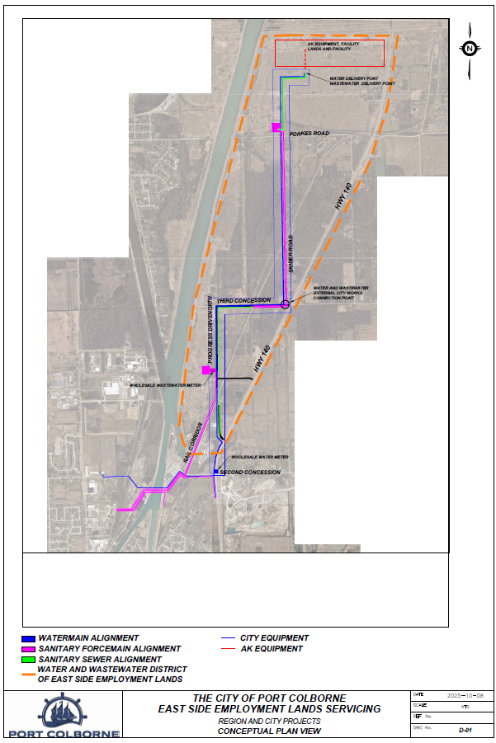
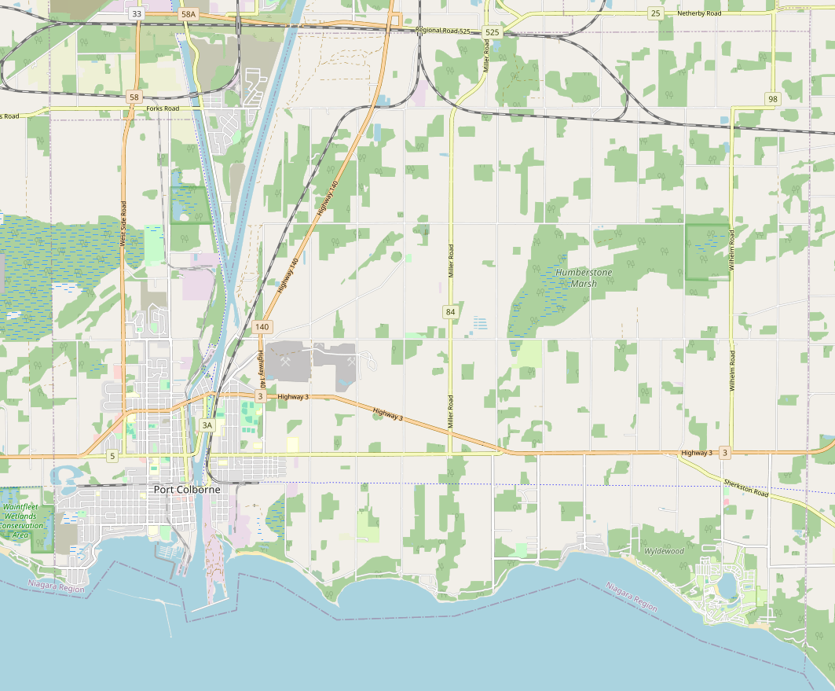
Appendix B: Geographic Location
New Housing
Second canal crossing of water and wastewater.
City portion up to $24.2 million subject to the Niagara Region agreement with respect to pumping stations and force mains.

Slide 38
© 2025 Doane Grant Thornton Corporate Finance Inc. A Canadian Member of Grant Thornton International Ltd. All rights reserved.

